Slide 1

NEUROPROSTHETIC GRASPING IMPROVEMENT USING sEMG AND DEEP GENERATIVE MODELING Advanced Deep Learning For Robotics
María Romeo Tricas – Jaume Gual Ramon
Dominik Winkelbauer

Slide 2
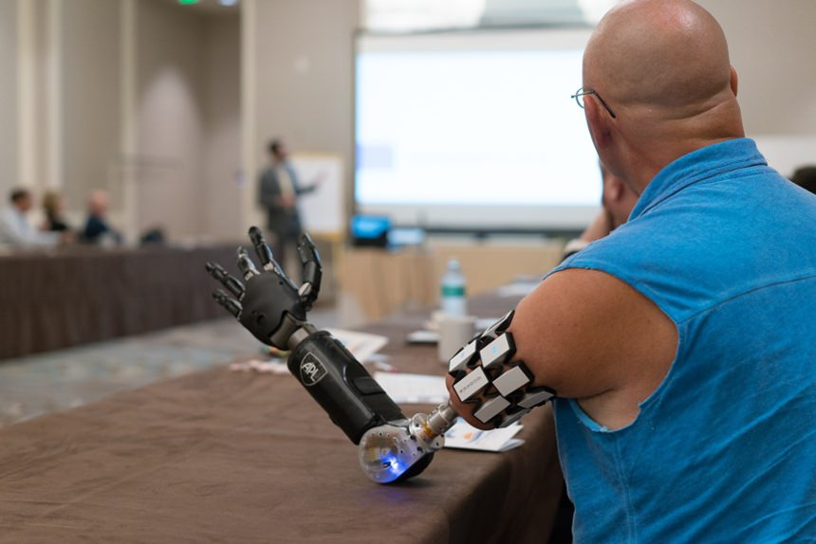
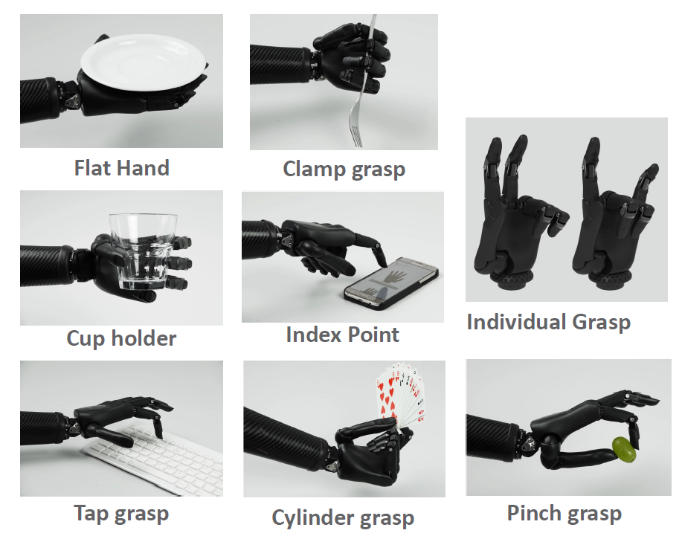
INTRODUCTION AND MOTIVATION
Abandon rate of neuroprosthetic devices for upper limb amputees → ≈ 50%
Due to:
Difficulties in usage control and grasping selection
Grasping selection is done with a switch…
Upper limb neuroprosthetic
Myoelectric hand graspings

Slide 3
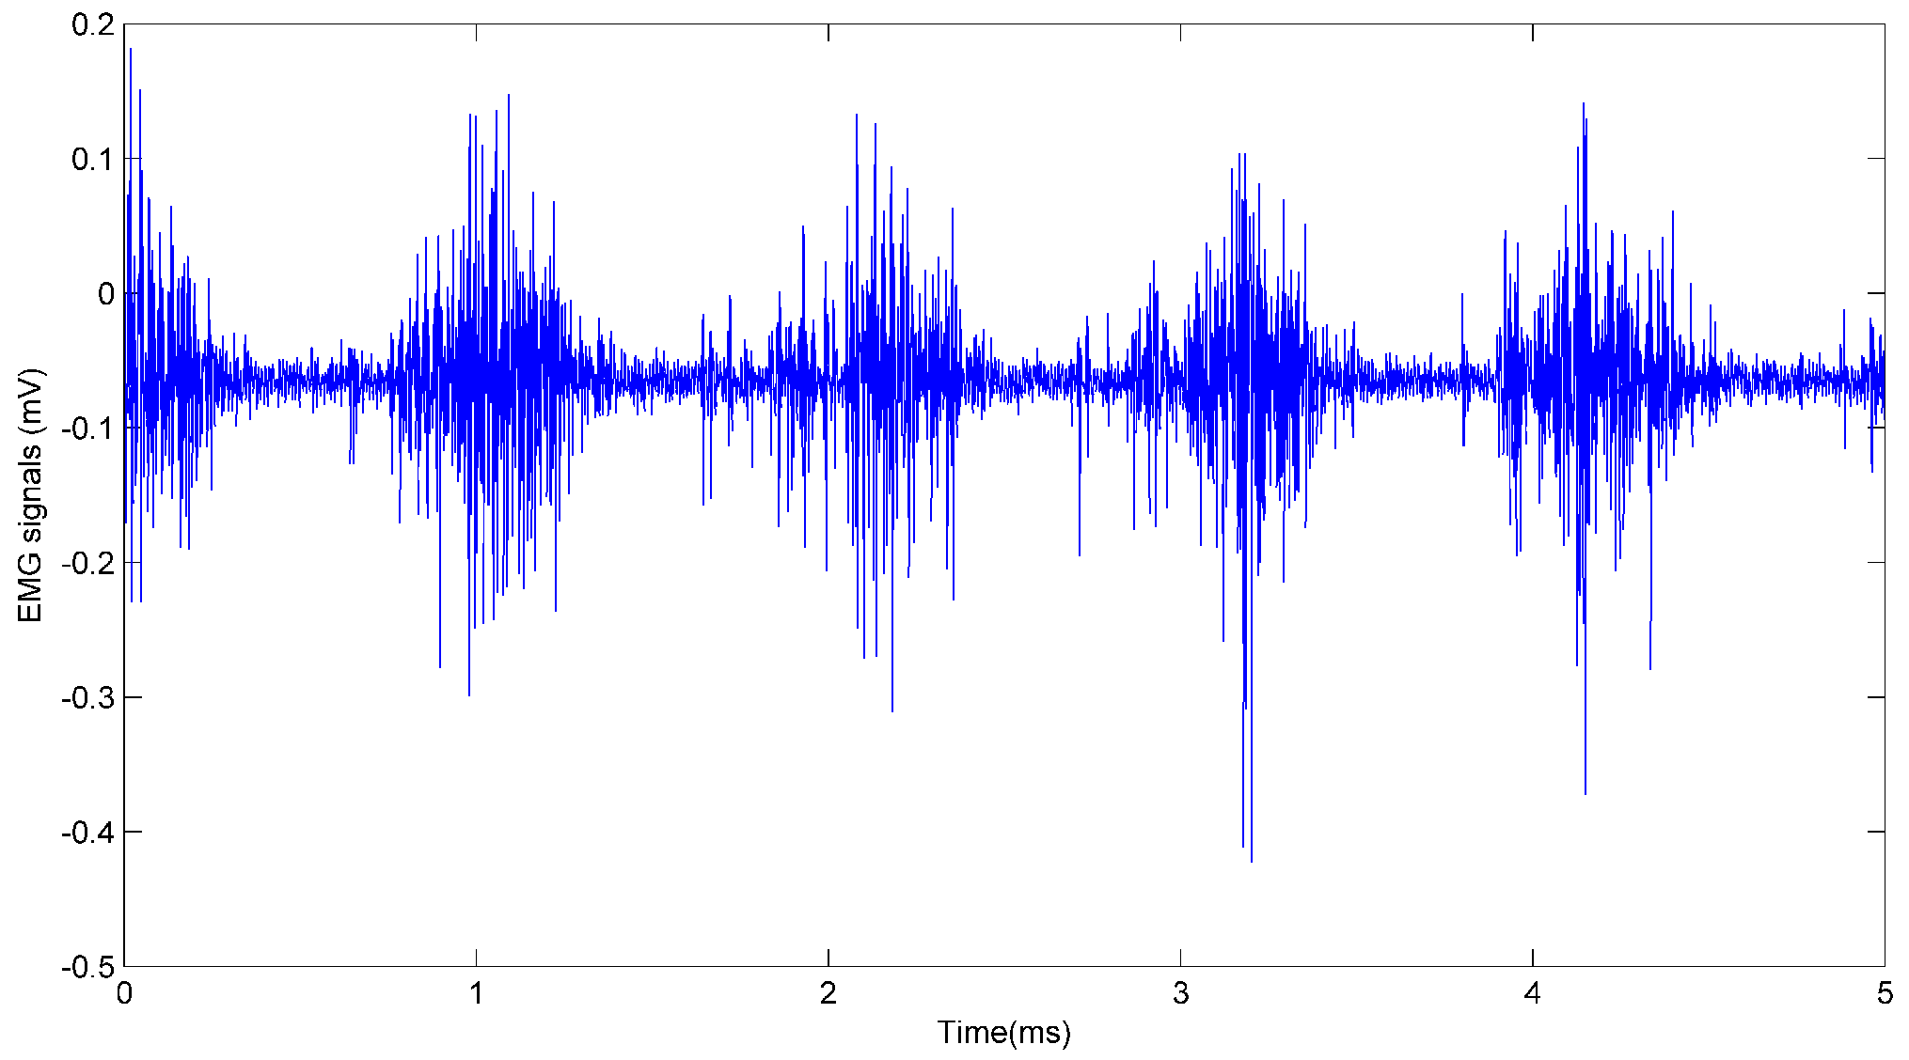
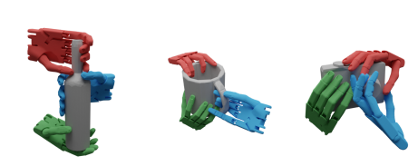
INTRODUCTION AND MOTIVATION
Our idea?
To develop a reliable and robust pipeline for generating graspings
Ease neuroprosthetics usage
Attending to the user needs with sEMG Through generative modeling

Slide 4
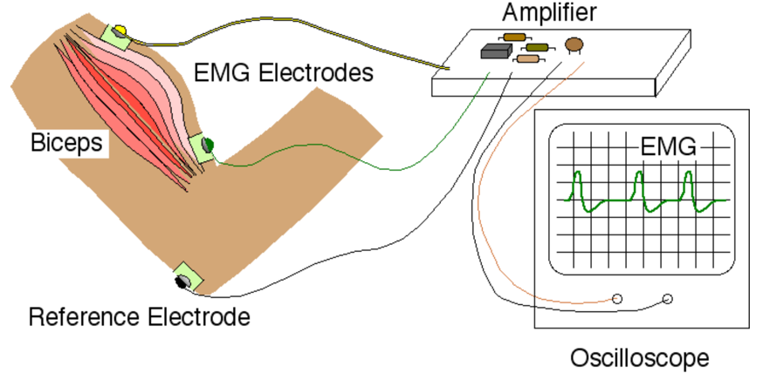
emg
What is EMG?
Electromyography is the graphic recording technique of electrical activity produced by skeletal muscles.
sEMG is obtained with surface electrodes on the muscles
Why EMG?
It is cheap, and it is non-invasive for users

Slide 5

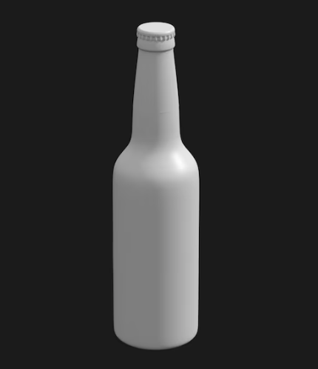
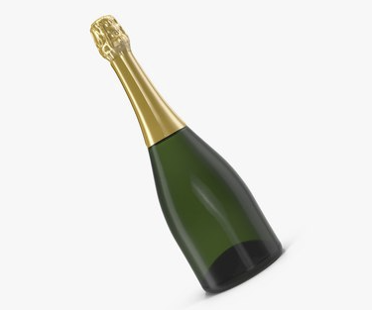
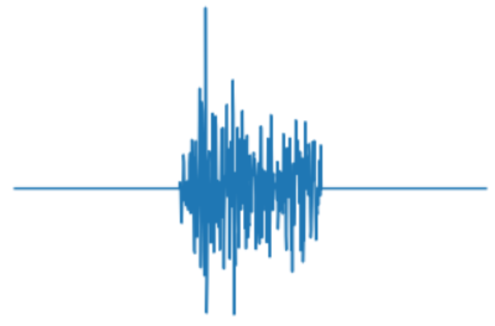
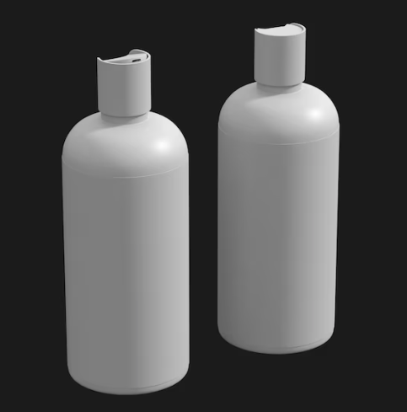
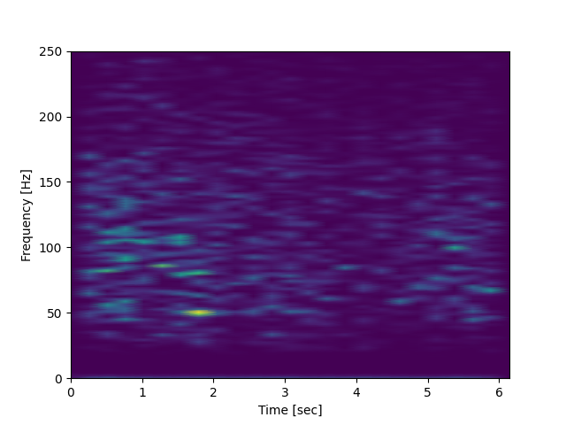
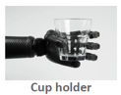
PIPELINE – 2 stages
sEMG Signals
User selects grasping intention through EMG
Feature extraction
ResNet-18 DL Classifier
Main Grasping Type
E.g. cylindrical

Slide 6
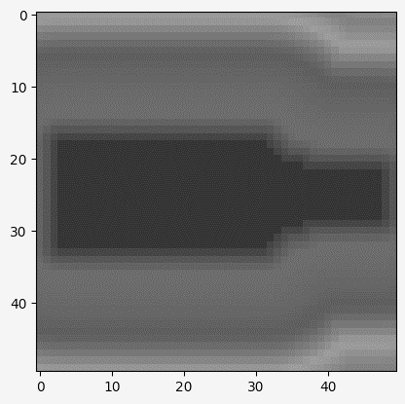
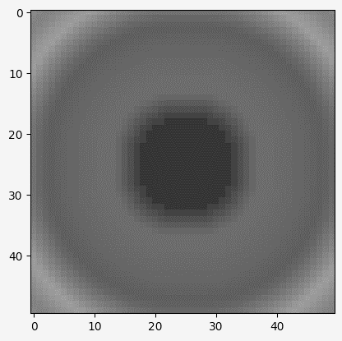
PIPELINE – 2 stages
sEMG Signals
User selects grasping intention through EMG
Extract 3D parameters of the object
Main Grasping Type
E.g. cylindrical

Slide 7
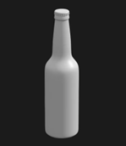
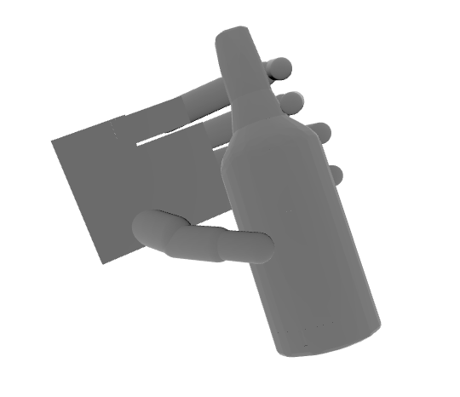
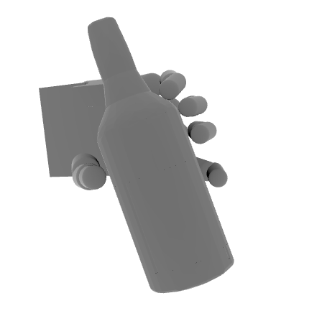
PIPELINE – 2 stages
sEMG Signals
Extract 3D parameters of the object
Bottle has… “characteristics”
User selects grasping intention through EMG
User wants… “cylindrical grasping”
Diffusion Model
Main Grasping Type
E.g. cylindrical
Fine-tuned hand pose

Slide 8

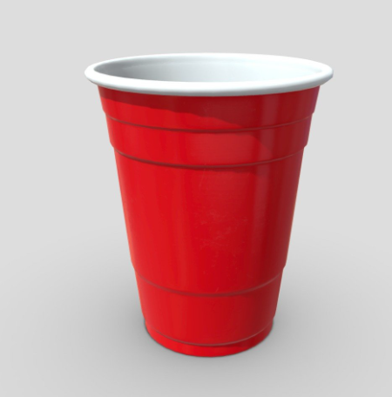
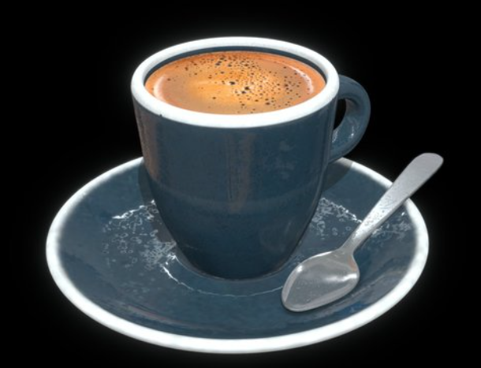
PIPELINE – 2 stages
Many different cups
User selects grasping intention through EMG
Extract cup parameters
and create 3D model
Deep Generative Modeling Architecture
Fine-tuned grasp for the desired object ☺

Slide 9
PIPELINE – 2 stages
Many different cups
User selects grasping intention through EMG
Extract cup parameters
and create 3D model
Deep Generative Modeling Architecture
Fine-tuned grasp for the desired object ☺

Slide 10
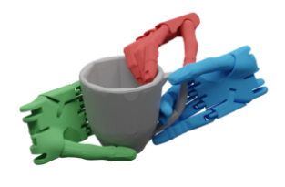
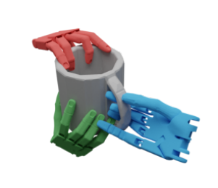
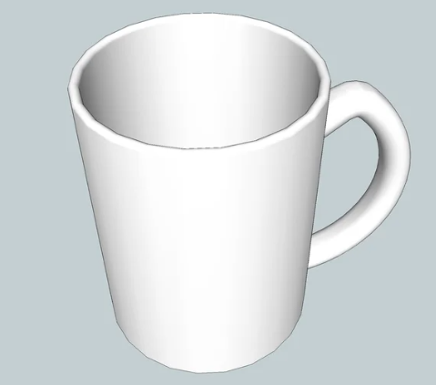

PIPELINE – 2 stages
DexGraspNet
Dataset with +5.000 objects, and +1.3 M grasps
Compare T,R,Θ
User selects grasping intention through EMG
Deep Generative Modeling Architecture
Inputs
Ground truth

Slide 11
First stage – emg classification

Slide 12
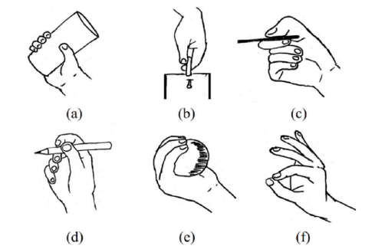
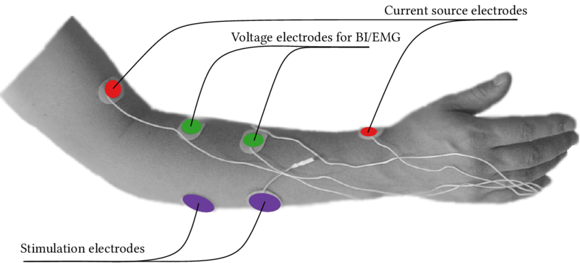
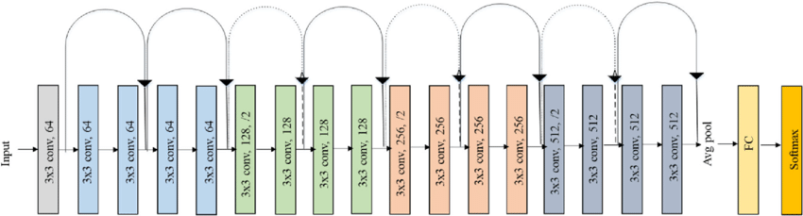
Technical outline RECAP – emg classification
User performs 6 grasps
Spectrograms (2 per trial)
Raw sEMG is recorded and processed
Grasp types
Power grasp d) Palm
Hook e) Sphere
Lateral f) Tip
User wants… “cylindrical grasping”
ResNet-18, 18 layers

Slide 13
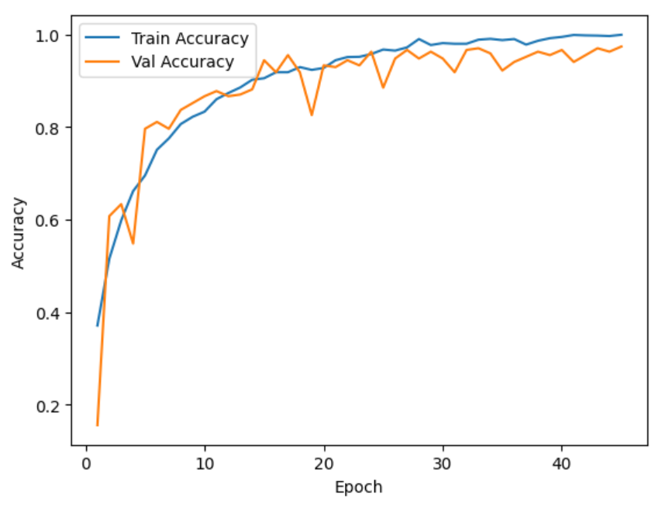
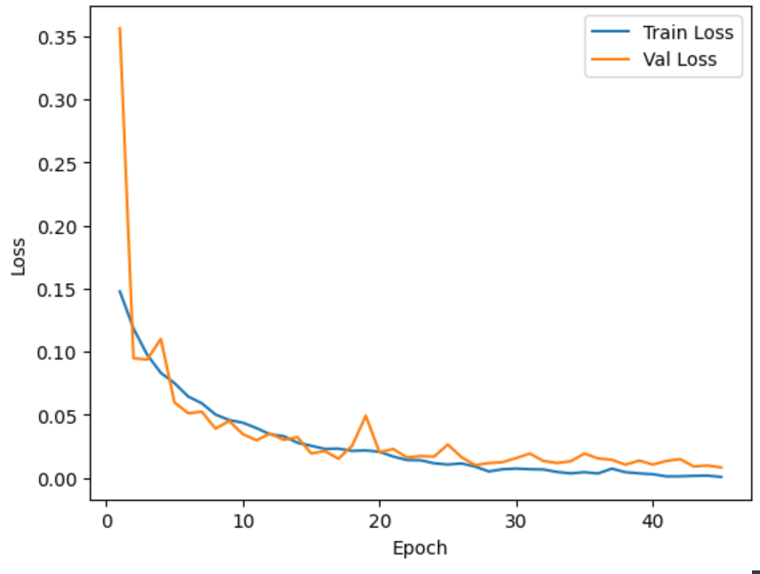
Results – emg classification
Source | Average (N=5) | Reference
Testing Accuracy | 95.5 | 99.5
Recall | 95.5 | 99.6
Precision | 94.9 | -
F1-Score | 94.7 | 99.6
Our results vs. Reference paper

Slide 14
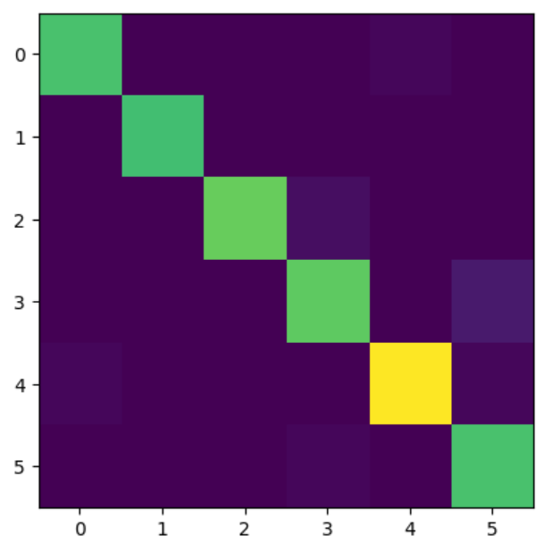
Results – emg classification
Cyl
Hook
Lateral
Palmar
Sphere
Tip
40
1
39
43
2
42
4
1
56
1
1
40

Slide 15
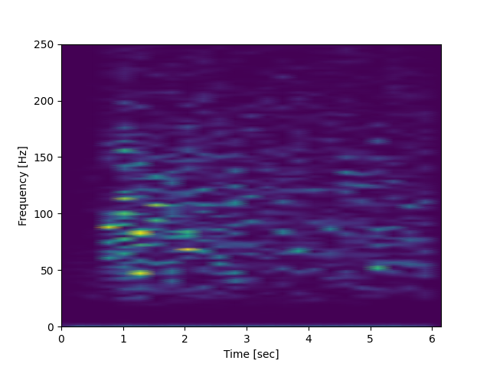
Technical outline – emg Dataset
450 samples per grasping → 2700 samples
Stack of 2 RGB images → [480 X 640 X 6]
Split → 80% - 10% - 10%

Slide 16
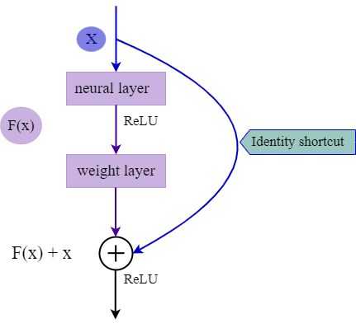
Classifier – Resnet-18
ResNet-18, 18 layers
Hyperparameters
Batch size | 10
Epochs | 40
Learning rate | 0.001
Momentum | 0.9
Residual Block
Optimizer: SGD + Momentum
Loss function: CE Loss

Slide 17
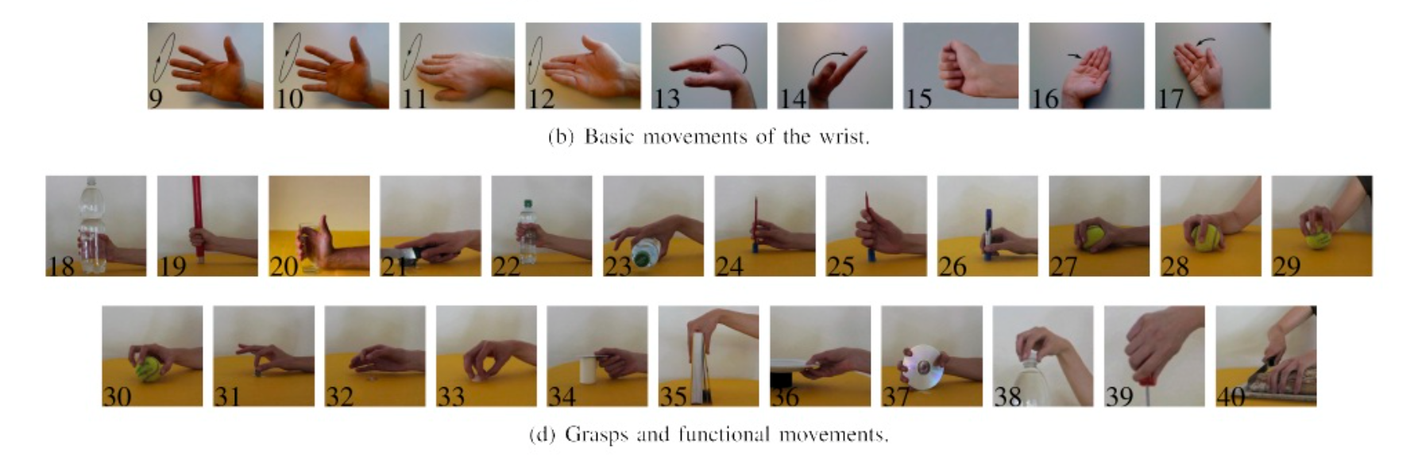
Technical outline – diffusion model
First part:
sEMG classification provided good results → similar to the reference paper
Future steps:
Extend sEMG dataset to more grasping types

Slide 18
Technical outline – diffusion model
First part:
sEMG classification provided good results → similar to the reference paper
Future steps:
Extend sEMG dataset to more grasping types

Slide 19
Discussion and future work
First part:
sEMG classification provided good results → similar to the reference paper
Future steps:
Extend sEMG dataset to more grasping types
Feed raw EMG to model → improvement in real-time performance
DL Classifier for Grasping Selection
Less computation than spectrograms!

Slide 20
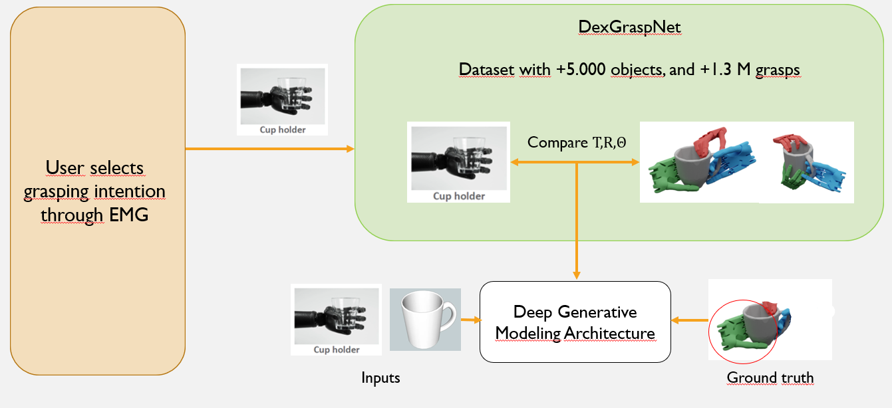
Discussion and future work
Second part:
Investigate DexGraspnet
Implement new pipeline

Slide 21
second stage – generative modeling

Slide 22
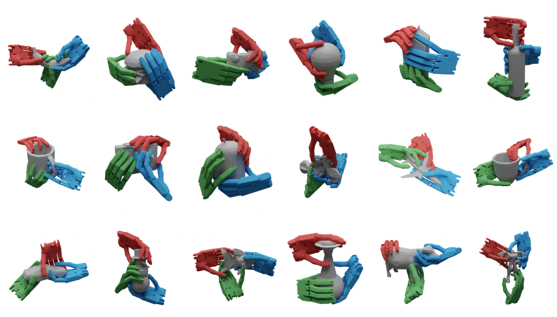
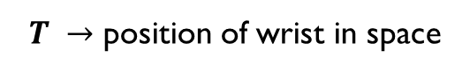
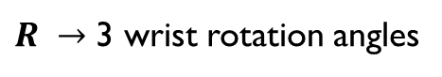
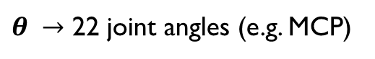

Technical outline – diffusion DATASET
Original Dataset – DexGraspNet
Large-Scale Robotic Dexterous Grasp Dataset for General Objects Based on Simulation
5.000 CAD objects
and
1.3 M generated grasps
Each grasp consisted of $\{θ, R, T\}$
$θ →$ 22 joint angles (e.g. MCP)
$R →$ 3 wrist rotation angles
$T →$ position of wrist in space

Slide 23
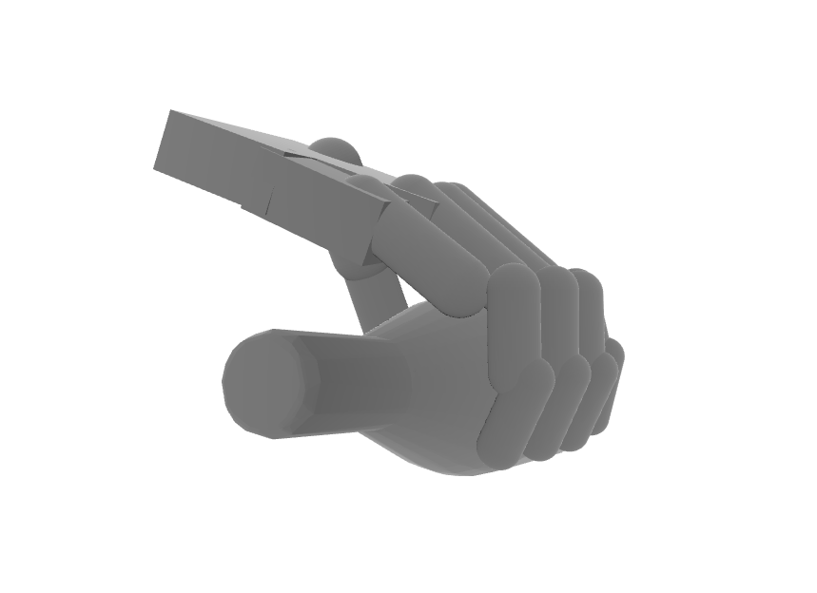
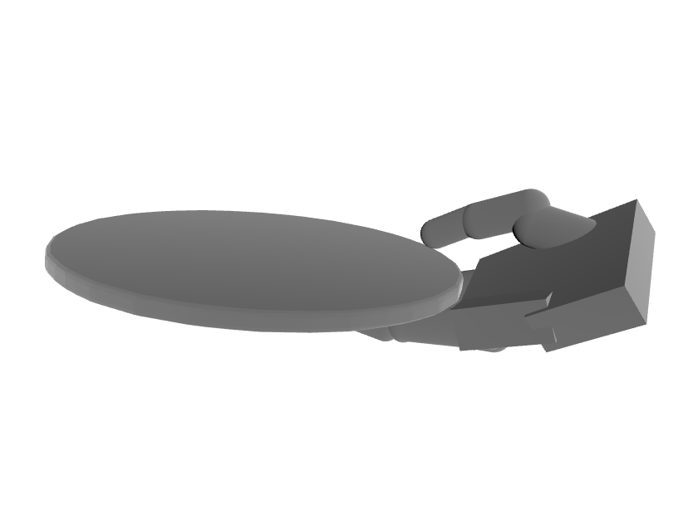
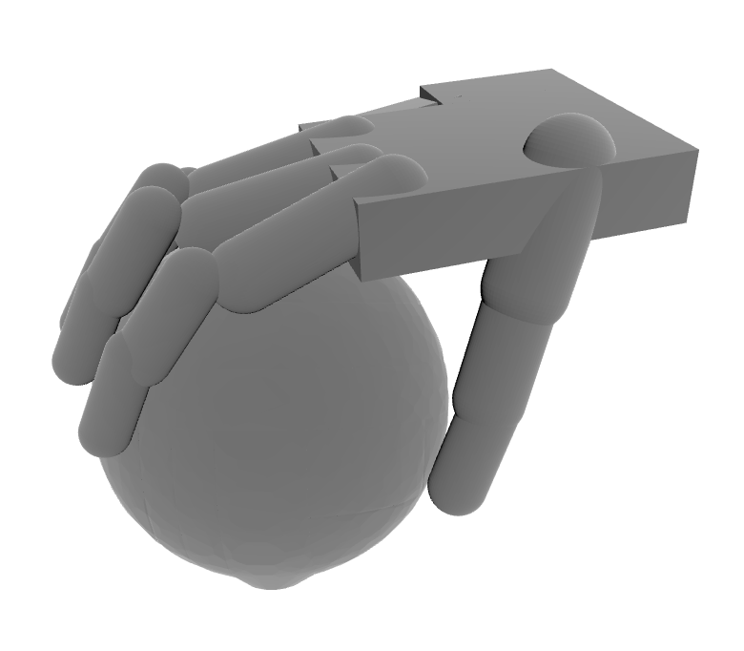
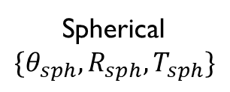
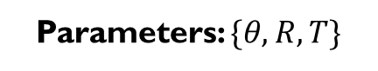
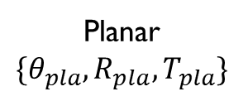
Technical outline – diffusion DATASET
DexGraspNet
Selected reference grasps
Cylindrical
Planar
Spherical
Parameters: $\{θ, R, T\}$

Slide 24
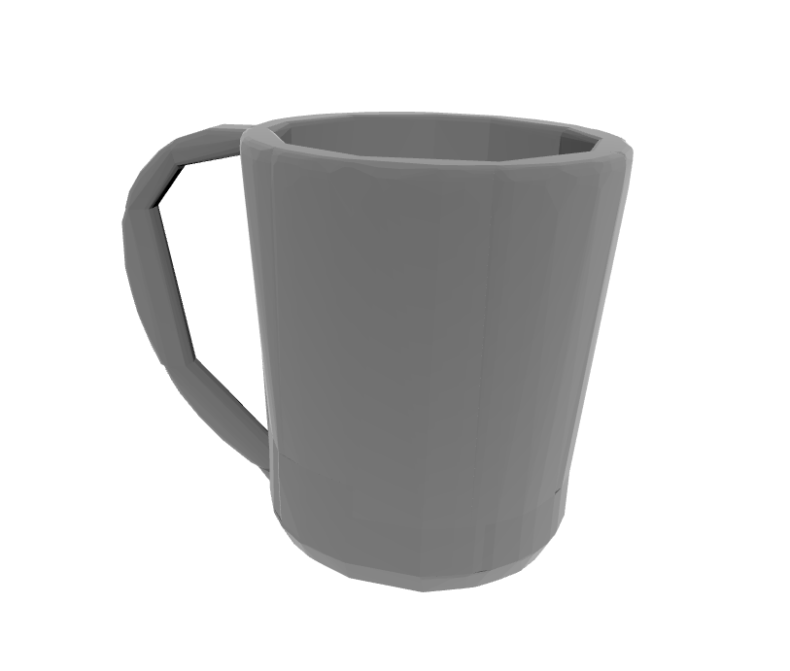
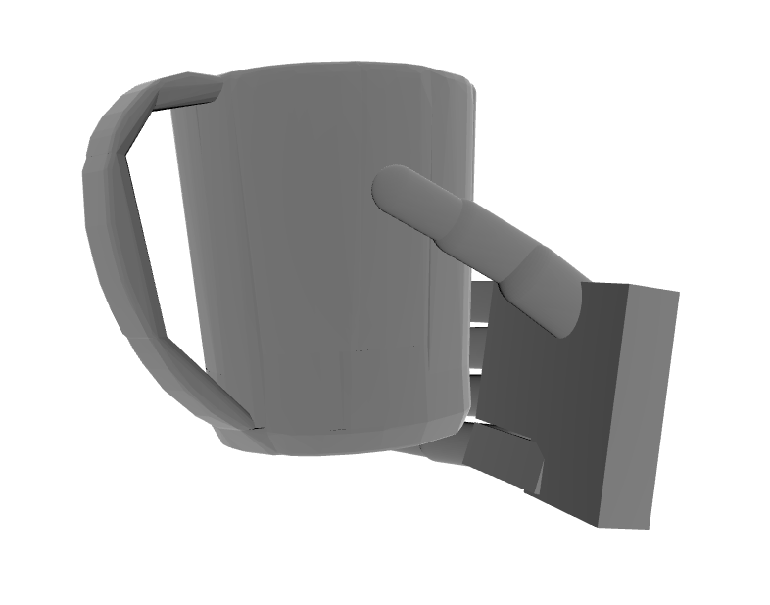

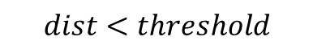
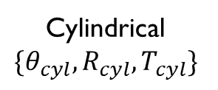
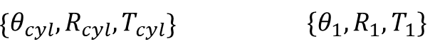
Technical outline – diffusion DATASET
DexGraspNet
Selected reference grasps
Random dataset object + all grasps
Cylindrical
Parameters: $\{θ, R, T\}$
$$\left\{θ_{cyl}, R_{cyl}, T_{cyl}\right\} \left\{θ_{1}, R_{1}, T_{1}\right\}$$
Euclidean distance for 28 dimensions of grasp
$$dist<threshold$$

Slide 25
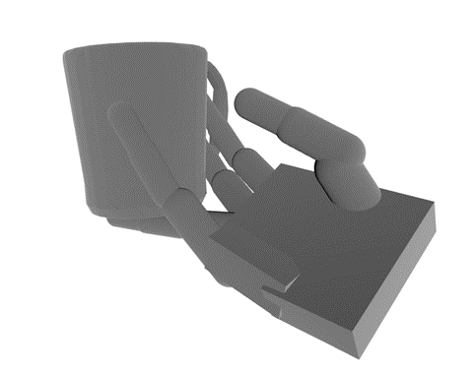

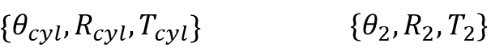
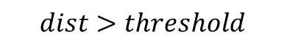
Technical outline – diffusion DATASET
DexGraspNet
Selected reference grasps
Random dataset object + all grasps
Cylindrical
Parameters: $\{θ, R, T\}$
$$\left\{θ_{cyl}, R_{cyl}, T_{cyl}\right\} \left\{θ_{2}, R_{2}, T_{2}\right\}$$
Euclidean distance for 28 dimensions of grasp
$$dist>threshold$$

Slide 26
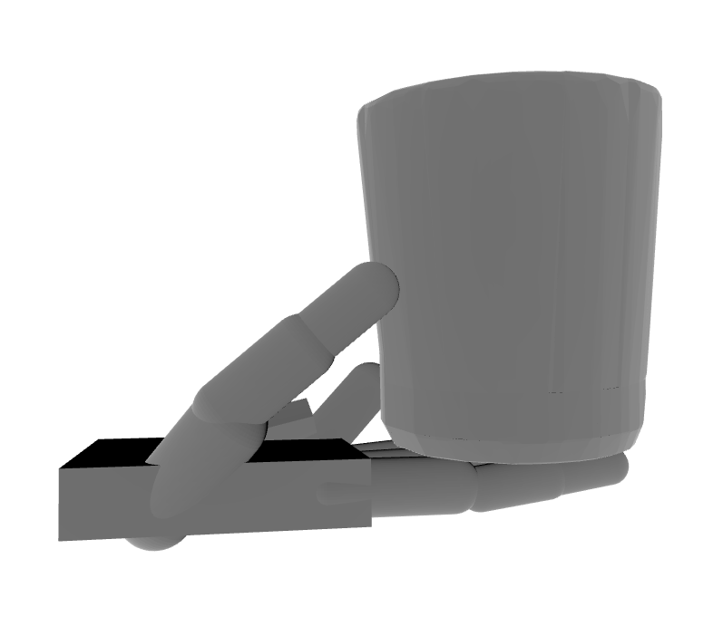



Technical outline – diffusion DATASET
DexGraspNet
Selected reference grasps
Refined Dataset
… … …
Cylindrical
Parameters: $\{θ, R, T\}$
1.000 objects and 21.000 grasps

Slide 27






Technical outline – diffusion model
Refined Dataset
Object embedding: Euclidean distance map
$$50×50×50$$
Grasp type:
One-hot vector
E.g., “cyl” = (1,0,0)
Grasp embedding:
Joint angles
$$22 joint angle$$
$$+3 rotation+3 translation$$

Slide 28



Technical outline – diffusion model
Each Sample
Object embedding: Euclidean distance map
$$50×50×50$$
DIFFUSION MODEL
Grasp type:
One-hot vector
E.g., “cyl” = (1,0,0)
Input
Output
Finetuned Grasp
$$28−dimensional$$
Conditioned on:
Desired grasp type
Input object
Grasp embedding:
Joint angles
$$28−dimensional$$

Slide 29
Technical outline – diffusion model
1: select a grasping for each grasp type from the DexGraspNet dataset
2: Create our dataset: look for the closer graspings (Euclidean Distance) for 1000 random objects. Each entry of our dataset: joint angles + trans + rot, type of grasping, mesh of distances.
3: prepare our diffusion model with inputs: joint angles + trans + rot, type of grasping, mesh of distances. Output: joint angles + trans + rot (28-dim).
4: Train our diffusion model (aqui explicar todos los pasos… 1 overfitting without object to 1 sample (solution: higher batch size and training longer), 2 overfitting with object, 3 overfitting for two samples, 4 training on full model (problem: translation y rotation), 5 training only on translation y rotation.

Slide 30








Diffusion model - characteristics
INPUT
Euclidean distance map
$$50×50×50$$
Object embedding
$$1x512$$
CONV3D
Joint angles:
$$28−dimensional$$
Grasp embedding:
$$1x1792$$
$(1792=64∗28$)
POSITIONAL EMBEDDING
Timesteps vector:
$$64−dimensional$$
Timesteps embedding:
$$1x64$$
POSITIONAL EMBEDDING
Grasp type:
One-hot vector
E.g., “cyl” = (1,0,0)
Grasp type:
$$1x3$$

Slide 31





Diffusion model - characteristics
Hyperparameters
Batch size | 64
Epochs | 200 / 250
Learning rate | 1e-4 / 1e-5
Time steps | 50
β (diffusion rate) | ‘linear’
Embedding size | 64
INPUT
Object embedding
$$1x512$$
OUTPUT
Grasp embedding:
$$1x1792$$
$(1792=64∗28$)
Optimizer: AdamW
Loss function: MSE Loss
Time embedding:
$$1x64$$
Finetuned Grasp
$$28−dimensional$$
Grasp type:
$$1x3$$

Slide 32




Diffusion model – TRAINING AND RESULTS
FULL MODEL
PLANAR GRASP
PLANAR GRASP
CYL GRASP
CYL GRASP

Slide 33



Diffusion model – TRAINING AND RESULTS
FULL MODEL
Rotation and translation sometimes fails…

Slide 34




Diffusion model – TRAINING AND RESULTS
ROTATION-TRANSLATION ONLY
PLANAR GRASP
PLANAR GRASP
CYL GRASP
CYL GRASP

Slide 35
Discussion and future work
First part:
sEMG classification provided good results → similar to the reference paper
Future steps:
Extend the sEMG dataset to more grasping types.

Slide 36
Discussion and future work
Second part:
Joint angles representation → almost PERFECT!
Translation and rotation representation → not consistent at all!
→ Dimensionality problem? Applying dimensionality reduction…
We also implemented dimensionality reduction with PCA:
→ PCA did not achieve to represent the reconstructed sample properly.

Slide 37
Discussion and future work
Future steps:
Implement different dimensionality reduction methods.
Think about different approaches to solve this problem.

Slide 38
NEUROPROSTHETIC GRASPING IMPROVEMENT USING sEMG AND DEEP GENERATIVE MODELING
María Romeo Tricas – Jaume Gual Ramon
Dominik Winkelbauer

